Slide 1


King County Washington
Housing Dataset Analysis
Author: Brennan Mathis

Slide 2
Problems
Assess predicting factors, and combinations of factors that affect value of home
Create model to predict housing prices based on criteria provided in dataset

Slide 3
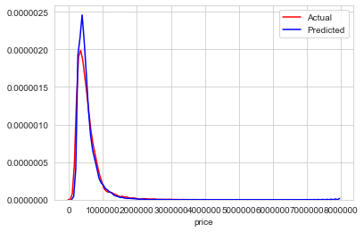
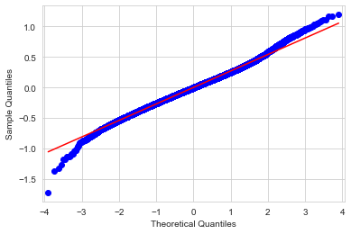
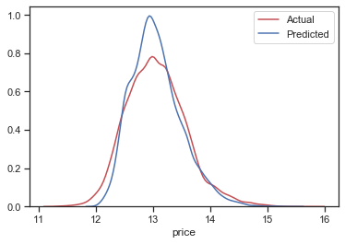
Regression Model
R squared 0.732

Slide 4
Factors Assessed
Bedroom
Bathroom
Living Area
Living Area of Neighbors
Grade
Condition
Age of House
Renovated Homes

Slide 5
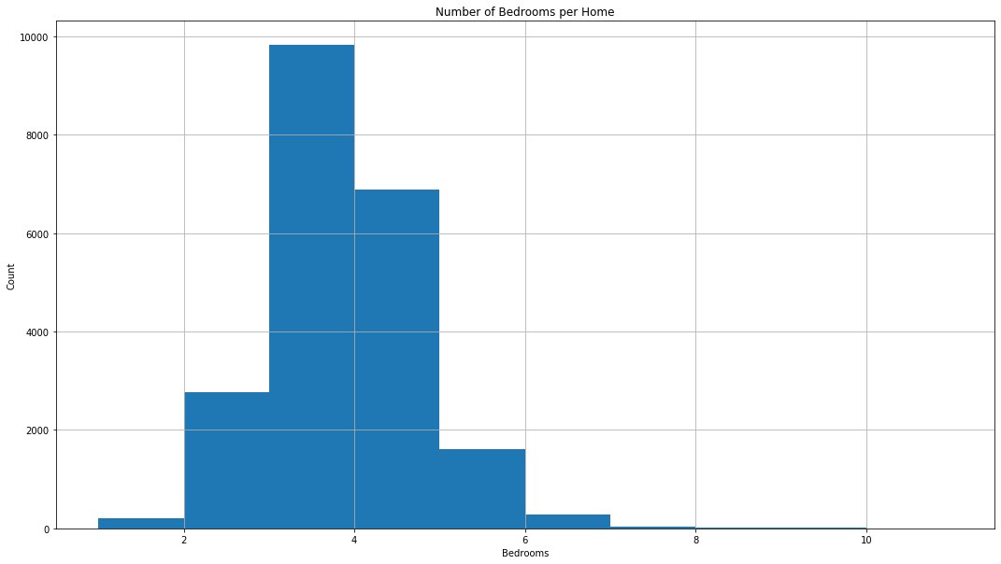
King County Housing Bedroom Analysis
Notes:
Overall Average Home Price: $540,297 Overall Average Number of Bedrooms: 3.4
3 bedrooms most common(mode), followed by 4 bedroom homes
1 BR House: $ 318,239
2 BR House: $ 401,387
3 BR House: $ 466,294
4 BR House: $ 635,565
5 BR House: $ 786,874
6 BR House: $ 825,854

Slide 6
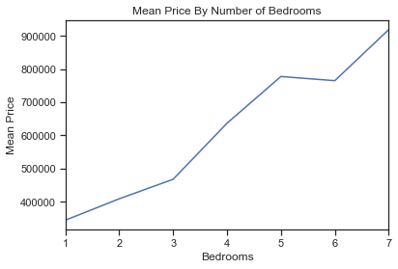
Spend & Save Value Per Bedroom
Notes:
Each bedroom in a home can increase the value of a home by an average of $127,573

Slide 7
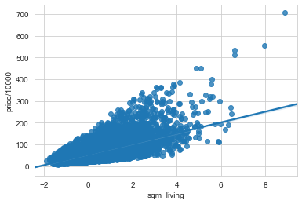
Square Meter Living Area Vs. Price ($10,000)
More Space = More Value
Notes:
Each individual square meter of living area
can increase value of the home by 0.4%

Slide 8
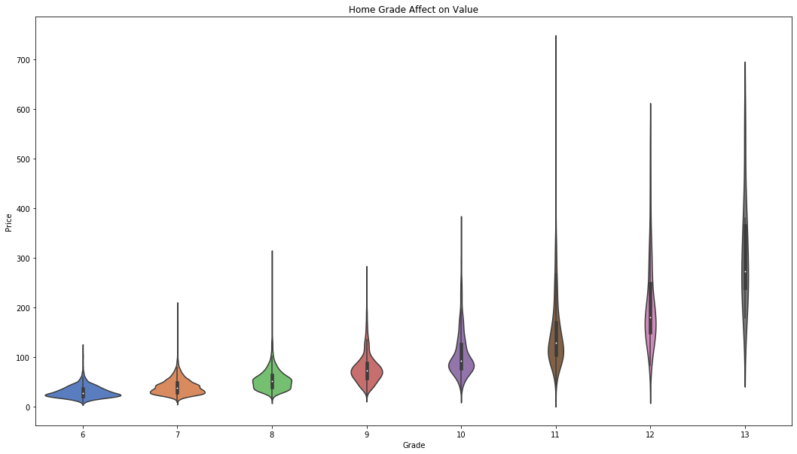
Grade Effect on Price
Every increase in grade unit can increase home value by 32%
Notes:
Every increase in grade unit can increase home value by 32%

Slide 9
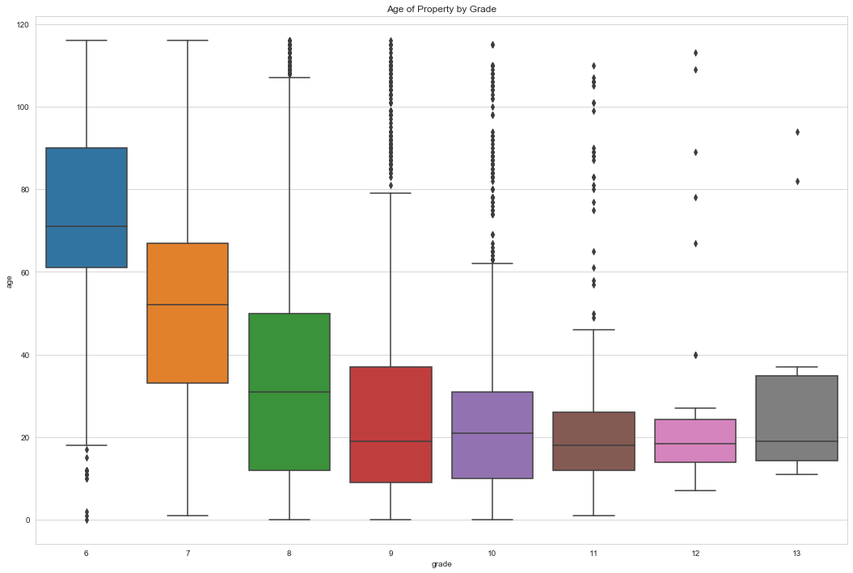
Relationship between Home Grade and Age
Notes:
Newer homes consistently earn higher grade during home inspections
Older homes trend lower average grades on home inspections
Recall that price average increases as grade increases

Slide 10
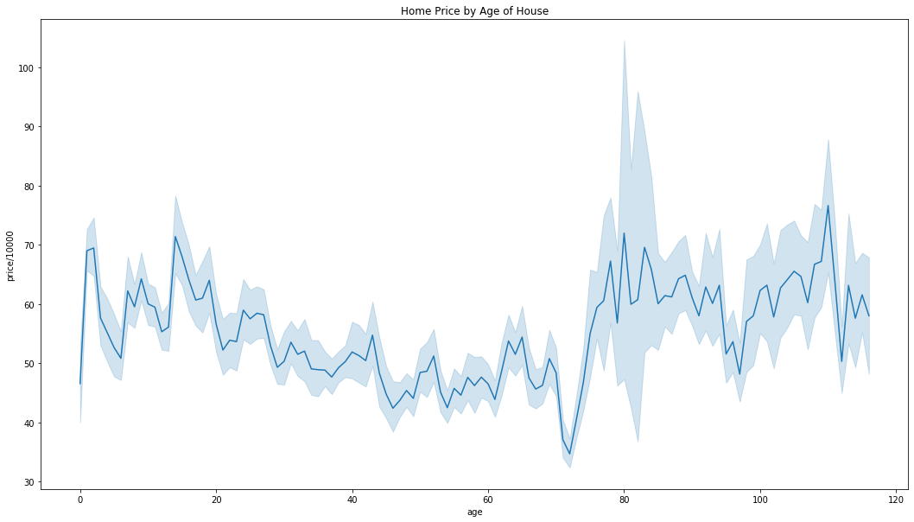
Home Age Affect on Value
Condition and Grade have a stronger overall effect on price, especially on older properties,
some of which present much higher values dependent on those criteria
Notes:
Strong deviation from mean of price occurs starting around home age of 75-80 years.
Example of how age can depreciate value as home ages
Renovating older homes can prevent the lower end of the price fluctution

Slide 11
Renovated Homes Non-Renovated Homes
Average Price: $ 768,902
Average Grade: 7.75 out of 13
3% of homes are renovated
Average Price : $ 532,140
Average Grade : 7.65 out of 13
97% of homes are not renovated
Average Price for Non-Renovated Homes with Grade over 7: $ 701,337
Renovating your home before selling can increase the value of your home by at least $60,000

Slide 12
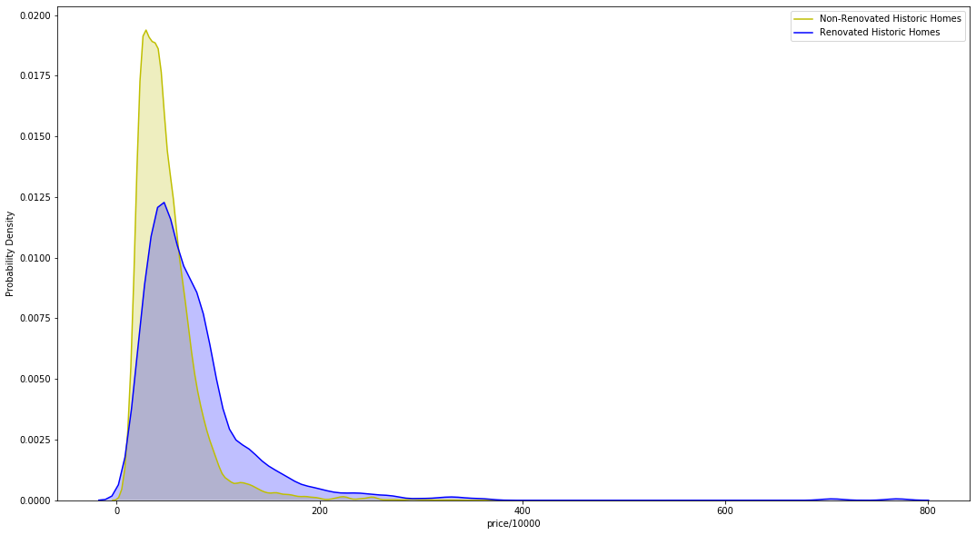
Renovation Effect on Homes Over 50 (Years Old)
Notes:
A historic house generally meets several criteria before being listed by an official body as "historic." Generally the building is at least a certain age, depending on the rules for the individual list. A second factor is that the building be in recognizably the same form as when it became historic. Third is a requirement that either an event of historical importance happened at the site, or that a person of historical significance was associated with the site, or that the building itself is important for its architecture or interior
Price on x axis
Density on y axis

Slide 13
Business Recomendations

Slide 14
Future Analysis

Slide 15
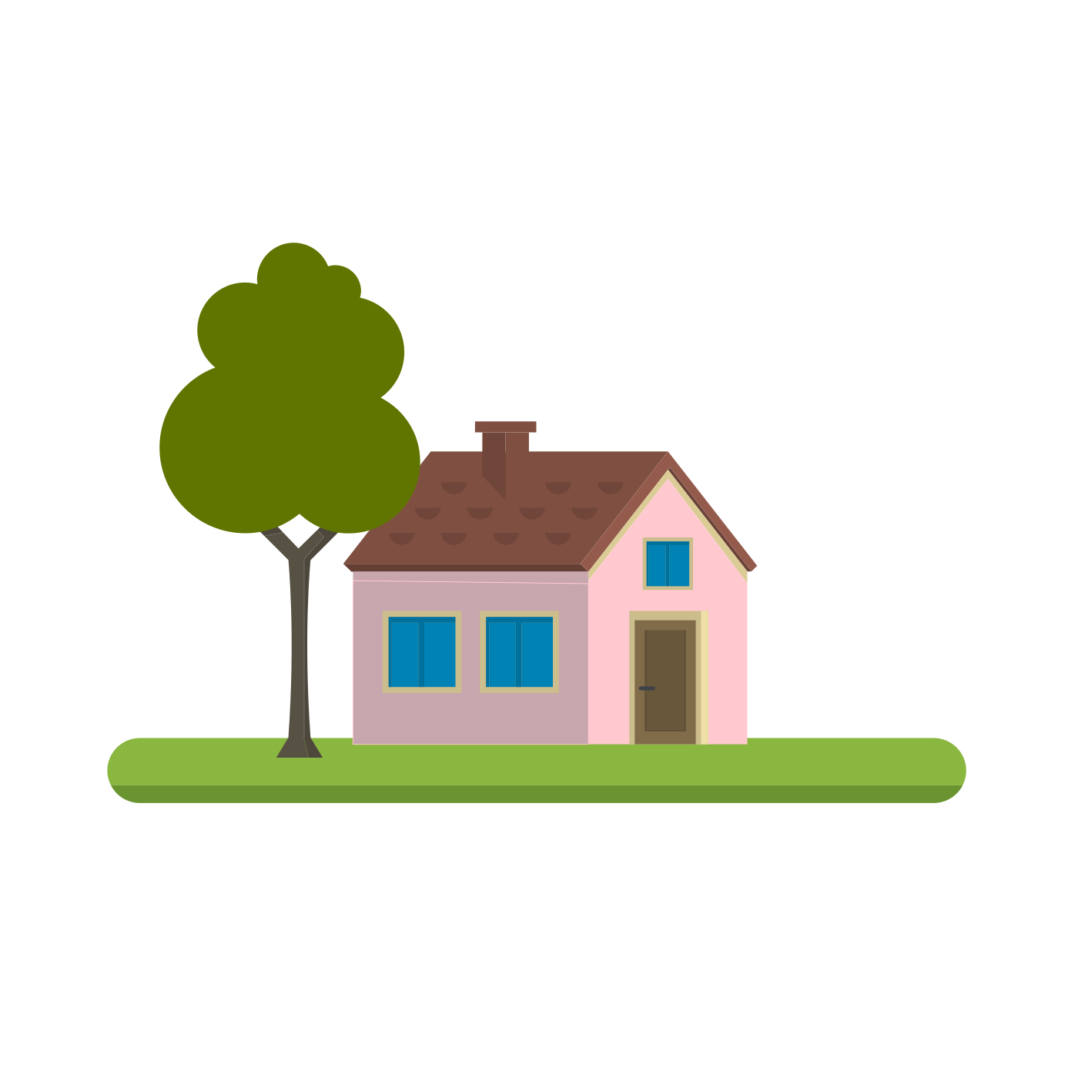
Thank you.

